Slide 1
“On the way with Python”

Slide 2
MD. SHAKIL
NSDA Certified Trainer & Assessor
Vendor Certified
IT Specialist in Python
Sr. Backend Developer
Ethical Den
Asst. Trainer
Daffodil International Professional Training Institute
Lead Trainer
eShikhon IT Training Institute
Lead Trainer
Wizard Software & Technology
📞 +88 01793-299882
✉️ shakil.eub.cse@gmail.com
🔗 https://www.linkedin.com/in/mrshakil015
🌐 https://mrshakil.com

Slide 3
Python Operators
Lecture
05

Slide 4
Introduction
In Python, operators are special symbols used to perform operations on variables and values. Operators help in performing calculations, comparisons, logical decisions, and data manipulation.

Slide 5
Types of Python Operator
Arithmetic Operators
Assignment Operators
Comparison Operators
Logical Operators
Bitwise Operators
Special Operators

Slide 6
Arithmetic Operators
Used to perform mathematical operations.
Operator | Operation | Example
+ | Addition | 5 + 2 = 7
- | Subtraction | 4 - 2 = 2
* | Multiplication | 2 * 3 = 6
/ | Division | 4 / 2 = 2
// | Floor Division | 10 // 3 = 3
% | Modulo | 5 % 2 = 1
** | Power | 4 ** 2 = 16

Slide 7
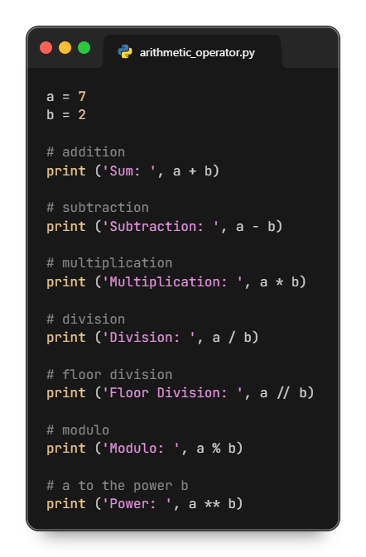
Arithmetic Operators

Slide 8
Assignment Operators
Used to assign values to variables
Operator | Name | Example
= | Assignment Operator | a = 7
+= | Addition Assignment | a += 1 # a = a + 1
-= | Subtraction Assignment | a -= 3 # a = a - 3
*= | Multiplication Assignment | a *= 4 # a = a * 4
/= | Division Assignment | a /= 3 # a = a / 3
%= | Remainder Assignment | a %= 10 # a = a % 10
**= | Exponent Assignment | a **= 10 # a = a ** 10

Slide 9
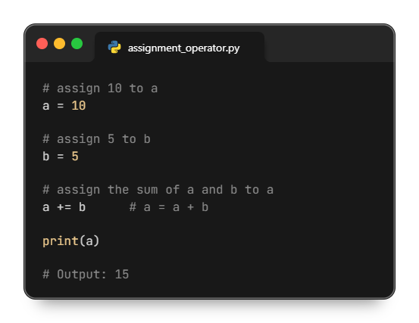
Assignment Operators

Slide 10
Comparison Operators
Used to compare two values. The result is always True or False.
Operator | Meaning | Example
== | Is Equal To | 3 == 5 gives us False
!= | Not Equal To | 3 != 5 gives us True
> | Greater Than | 3 > 5 gives us False
< | Less Than | 3 < 5 gives us True
>= | Greater Than or Equal To | 3 >= 5 give us False
<= | Less Than or Equal To | 3 <= 5 gives us True

Slide 11
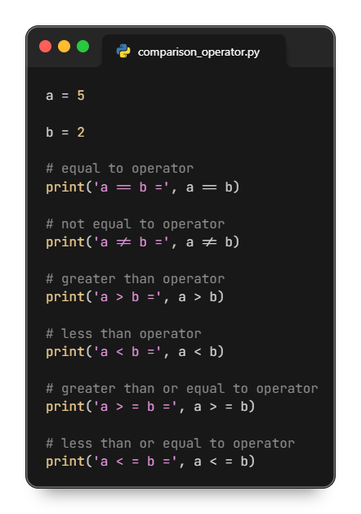
Comparison Operators

Slide 12
Logical Operators
Used to combine conditional statements
Operator | Description | Example
and | True if both are True | True and False → False
or | True if any one is True | True or False → True
not | Reverses the result | not True → False

Slide 13
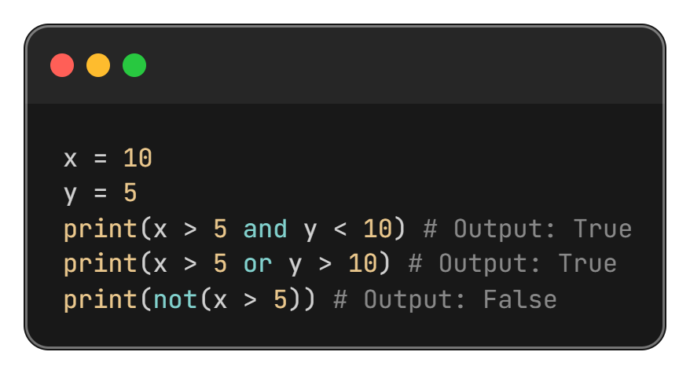
Logical Operators

Slide 14
Bitwise Operators
Used to perform operations at the binary (bit) level.
Operator | Description | Example
& | AND | 5 & 3 = 1
| | OR | 5 | 3 = 7
^ | XOR | 5 ^ 3 = 6
~ | NOT | ~5 = -6
<< | Left Shift | 5 << 1 = 10
>> | Right Shift | 5 >> 1 = 2

Slide 15
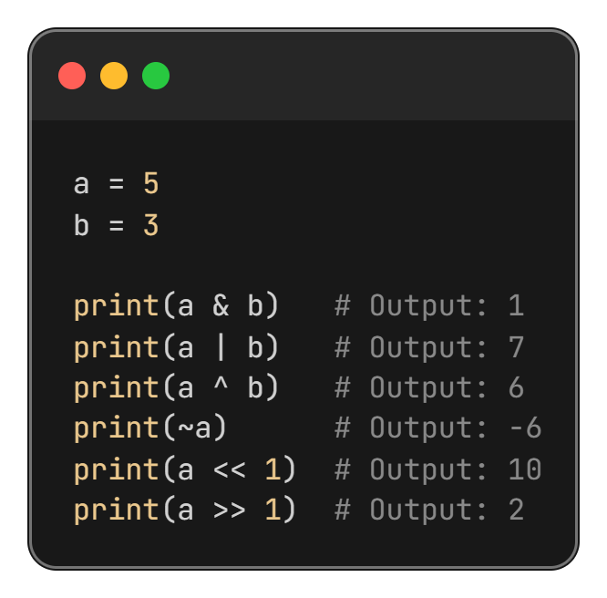
Bitwise Operators

Slide 16
““Thanks All””

